Slide 1

Accommodation Suggestion System using Craigslist API
Improving the Online Experience
Presentation by
Anu Priya,
Meru Bhatnagar,
Prabhat Johl
Prateek Singh

Slide 2


Content
01
Objective
Assumptions
Business Idea
Constraints
Future Scope

Slide 3
Objective
02
Job seekers normally tend to look for the best accommodation available in the vicinity of hiring company’s location.
However, they face difficulty finding good residencies closeby as they have been relocated to new city or country for that matter.
The main objective of this project is to help these people by displaying the best available rented flats available nearby the company.

Slide 4
Why there is a need?
03
Getting information off the internet is like taking a drink from a fire hydrant-Mitchell Kapor
Information Overload
User Experience
Revenues
Recommender Systems help in addressing information overload problem by retrieving the information desired by the user
Based on his or similar users preferences and interests.

Slide 5
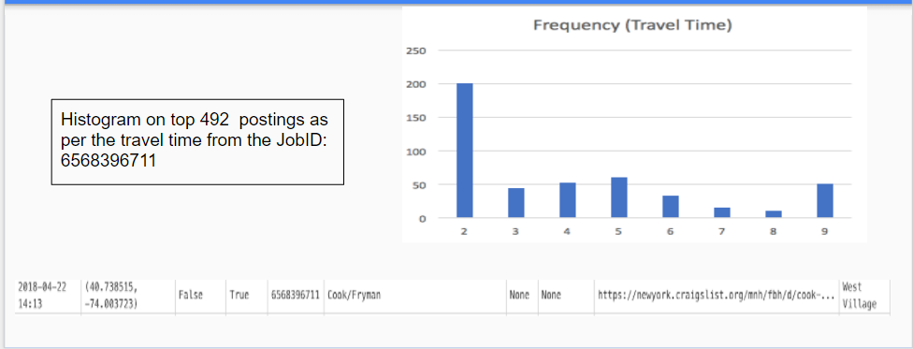
How it works ?
04

Slide 6
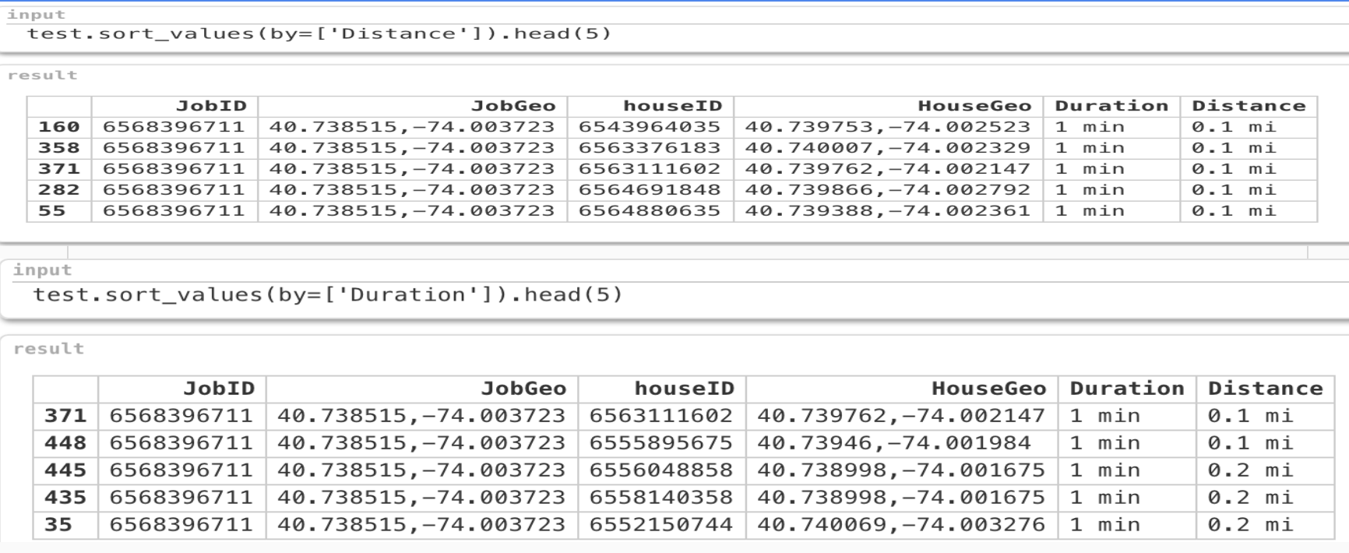
Recommendations on the basis of Travel duration/Distance
05

Slide 7
Assumptions
06
Job seeker is looking for full time employment.
We are considering the flats that are available only on rent and not for sale.

Slide 8
Business Idea
07
By integrating this tool with any classified advertisements web or mobile application, we can increase the number of user hits in the application.
Increasing in hits would be very lucrative for big time advertisers who would want to sponsor ‘’pay per click view’’ in the application.
Users will visit the recommendations as that would be ease them from there further accommodation hunting.
New York has a complete population of roughly 8.5 million out of which we are considering a cluster of around 12K job seekers ( Consider API constraint).
According to Indeed there are 128,492 jobs in New York City. If we target 10% of the job postings by the law of average then 12 k job seekers will use the application.

Slide 9
Constraints
08
Part of New York city has been used for this project because of Craigslist API constraints.
Couldn’t implement machine learning algorithms due to absence of historical data of user profiles
Geotags were missing for certain postings.

Slide 10
Future Scope
09
Customizing recommendation as per the need of seeker.
Mapping temporary accommodations to the customer who lookout for Internships and small tenure positions.
Machine Learning algorithms like KNN and Byers classifier can be used for better suggestions as per the user preference.

Slide 11
10
Thank you !!

